Slide 1
Fuzzy Logic

Slide 2
Uncertainty Studies
Uncertainty Study
Qualitative
Reasoning
Probability Based
Information Theory
based
Fuzzy Logic Based
Probabilistic
Reasoning
Markov
Processes
& Graphical
Models
Entropy
Centric
Algos
Bayesian Belief Network

Slide 3
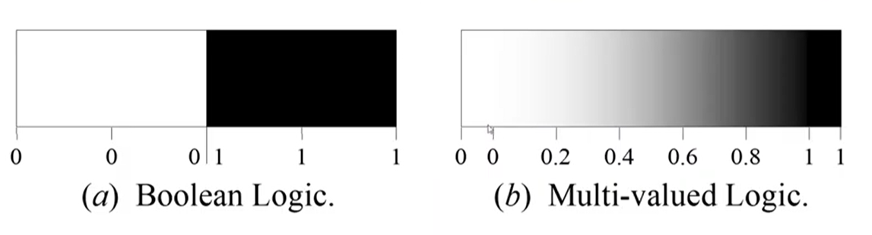
Fuzzy Logic
Fuzzy logic (multiway logic) is a way to model logical reasoning where the truth of the statement is not binary
Absolutely false 0
Absolutely true 1

Slide 4
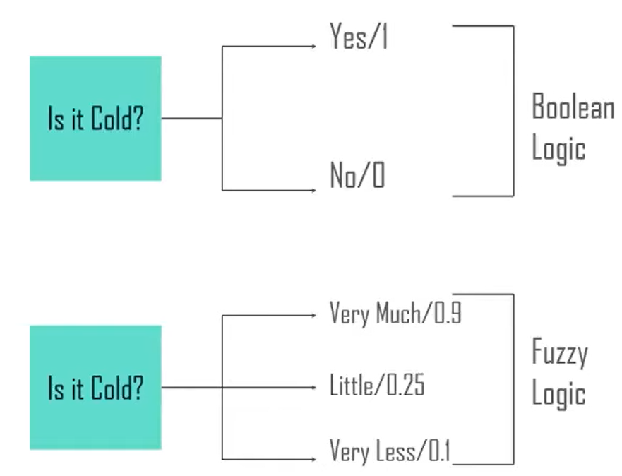
Fuzzy logic is a method of reasoning that resembles human reasoning. This approach is similar to how humans perform decision making and it involves all intermediate possibilities between yes and no

Slide 5
Cold
Pleasant
Hot
0 10 18 20 25 30 35 40 50
Temperature

Slide 6
Tall
Very Tall
Quite Tall
Somewhat tall
How to handle this ambiguity?
Not tall
Short
Is not tall same as Short?

Slide 7
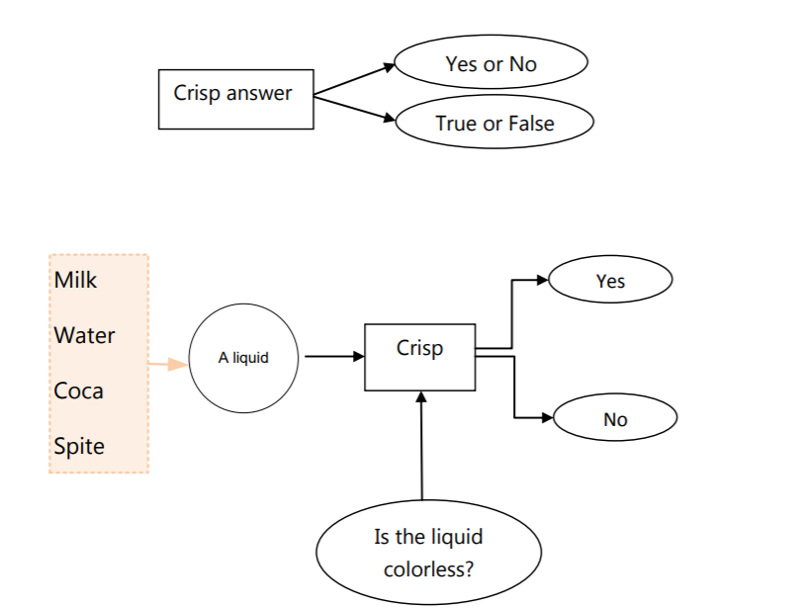
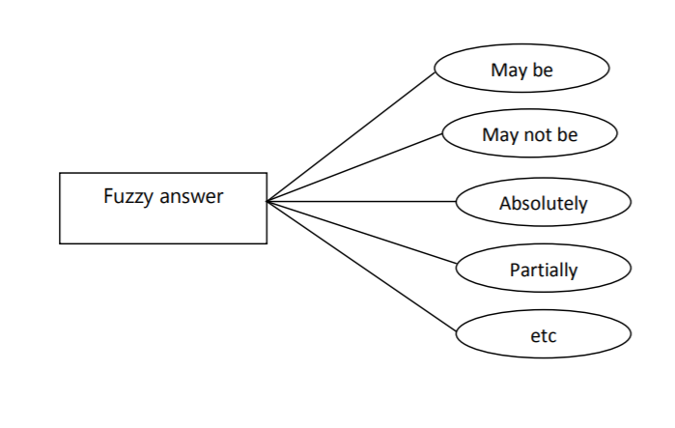

Slide 8
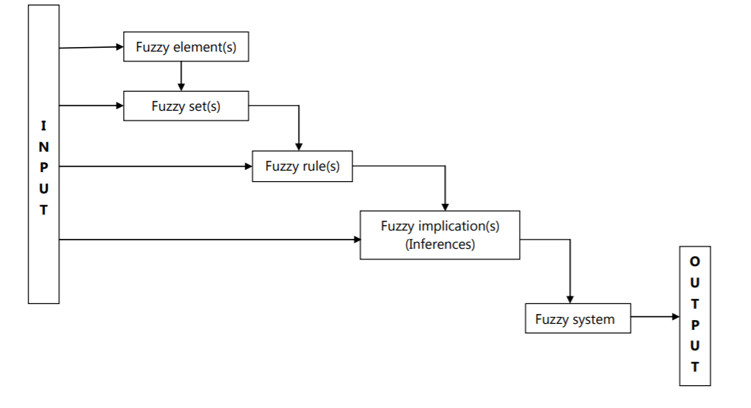

Slide 9
Fuzzy Logic tries to capture the human ability of reasoning with imprecise information
Models Human Reasoning
Works with imprecise statements such as:
In a process control situation,
“If the temperature is moderate and the pressure is high, then turn the knob slightly right”

Slide 10
Fuzzy Set
Fuzzy set theory is a generalization of classical set theory also called Crisp Set Theory
Classical set theory - belongingness predicate, μ, value is 0 or 1.
Fuzzy theory - belongingness predicate - μ_{s}(e) = [0, 1]
Example: Let, T = set of “tall” people
μ_{T} (Ram) = 1.0, μ_{T} (Shyam) = 0.2
Shyam belongs to T with degree 0.2.

Slide 11
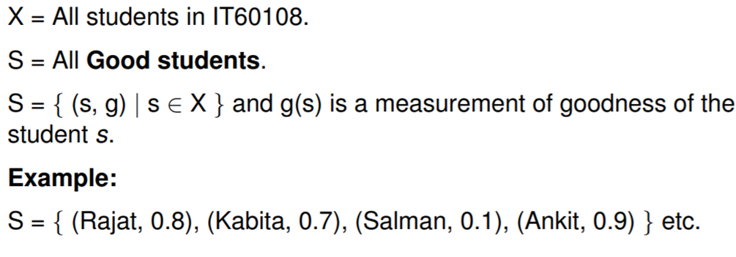
Fuzzy Set – example

Slide 12
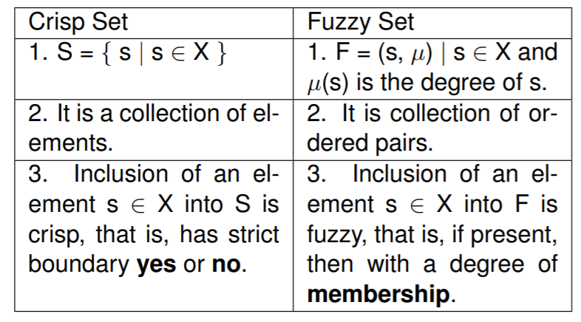
Crisp set Vs Fuzzy set

Slide 13
Representation of Fuzzy sets
Let U = {x₁,x₂,…..,x_{n}}
|U| = n
The various sets composed of elements from U are presented as points on and inside the n-dimensional hypercube. The crisp sets are the corners of the hypercube.
μ_{A}(x₁)=0.3
μ_{A}(x₂)=0.4
(0,1)
(1,1)
x₂
(x₁,x₂)
U={x₁,x₂}
x₂
A(0.3,0.4)
(0,0)
(1,0)
_{Φ}
x₁
x₁
A fuzzy set A is represented by a point in the n-dimensional space as the point {μ_{A}(x₁), μ_{A}(x₂),……μ_{A}(x_{n})}

Slide 14
Fuzzy Membership functions
Consider fuzzy set A, A = {(x, µA(x))| x Є X}
- µA(x) is called the membership function for the fuzzy set A.
X is referred to as the universe of discourse.
The membership function associates each element x Є X with a value in the interval [0, 1].

Slide 15
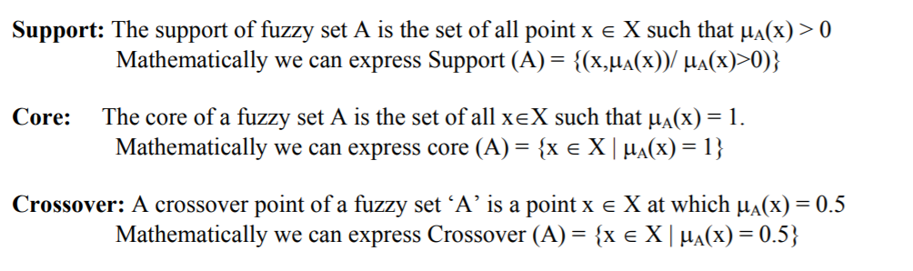
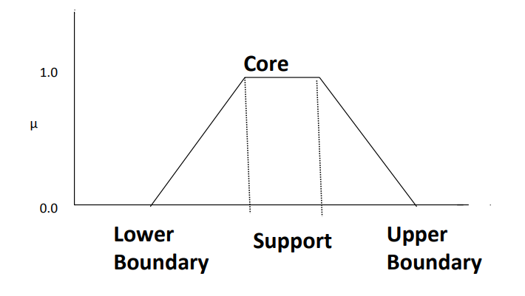
Features of membership function

Slide 16
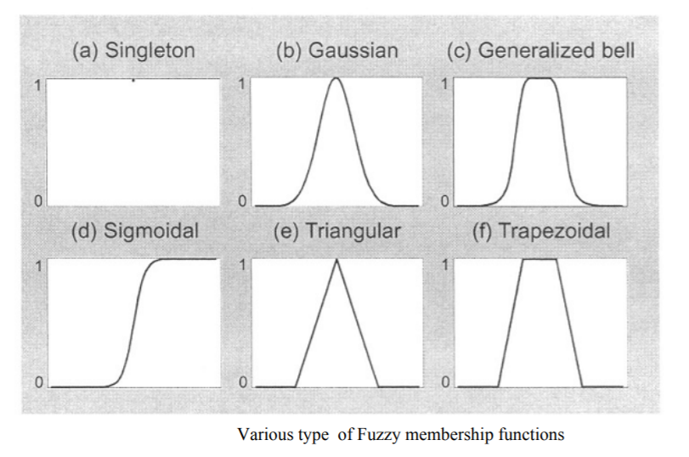
Membership functions

Slide 17
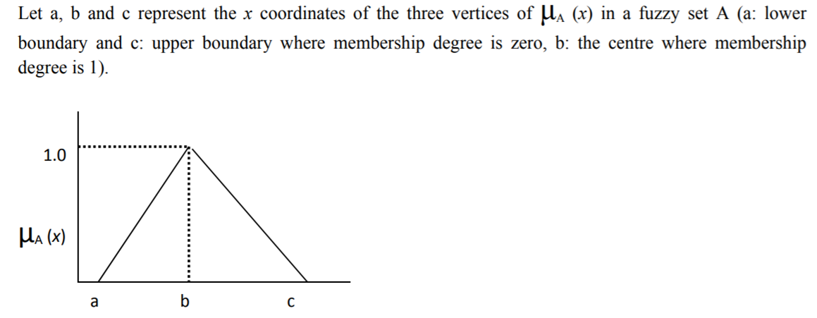
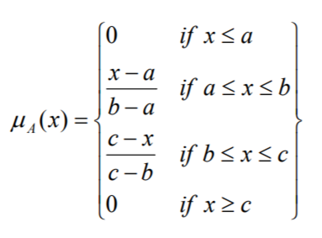
Triangular membership function

Slide 18
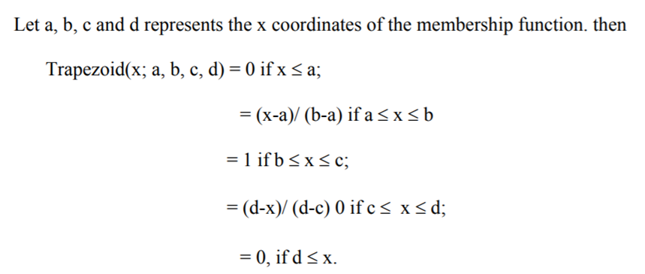
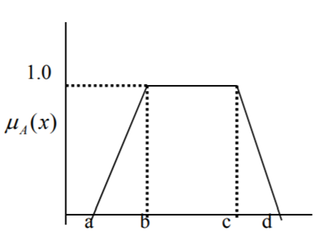
Trapezoidal membership function

Slide 19
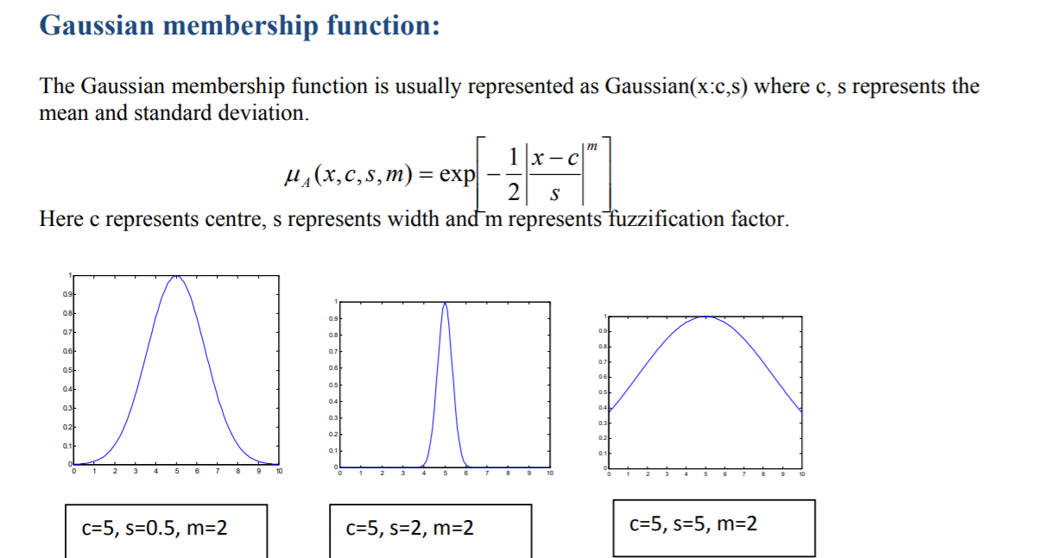

Slide 20
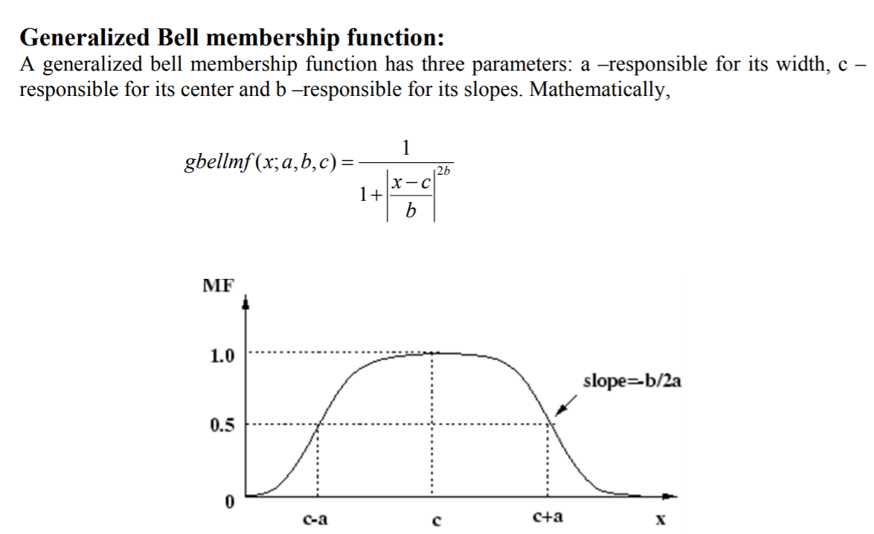

Slide 21
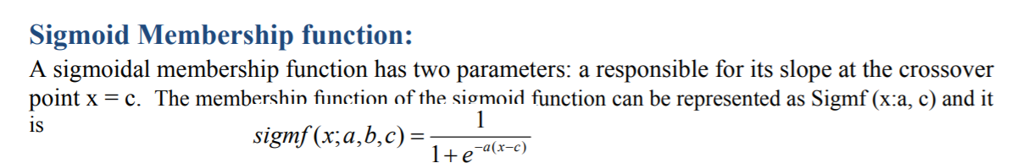
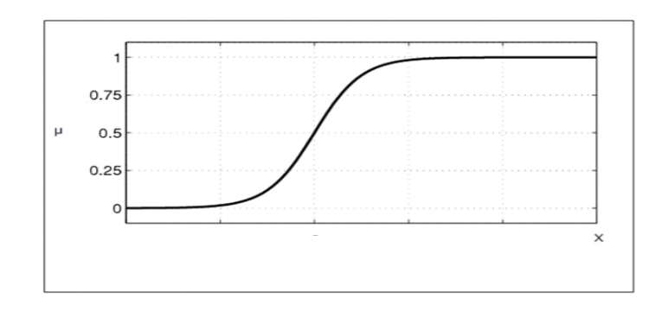

Slide 22
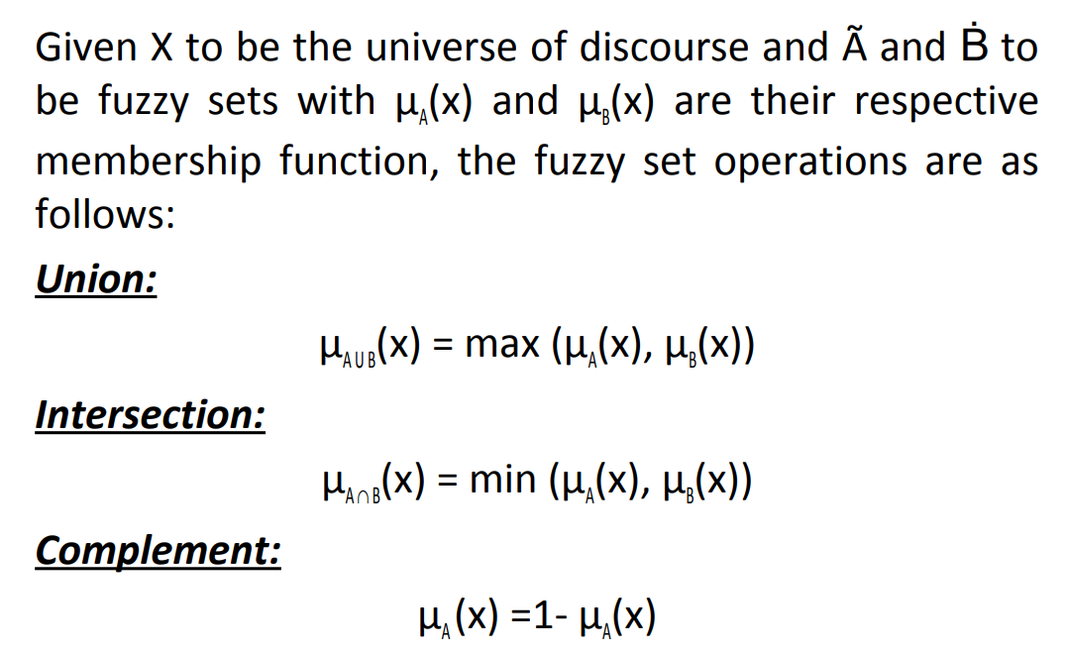
Operations on Fuzzy set

Slide 23
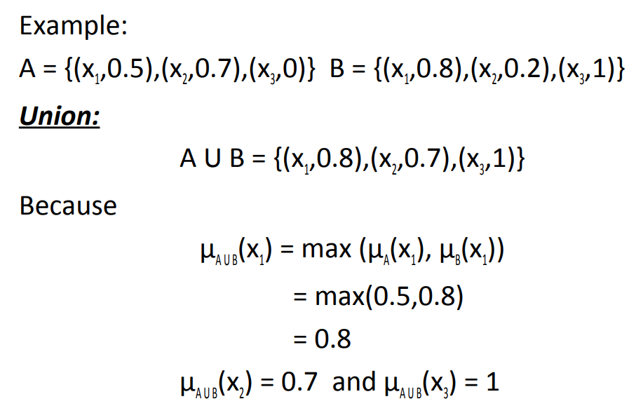

Slide 24
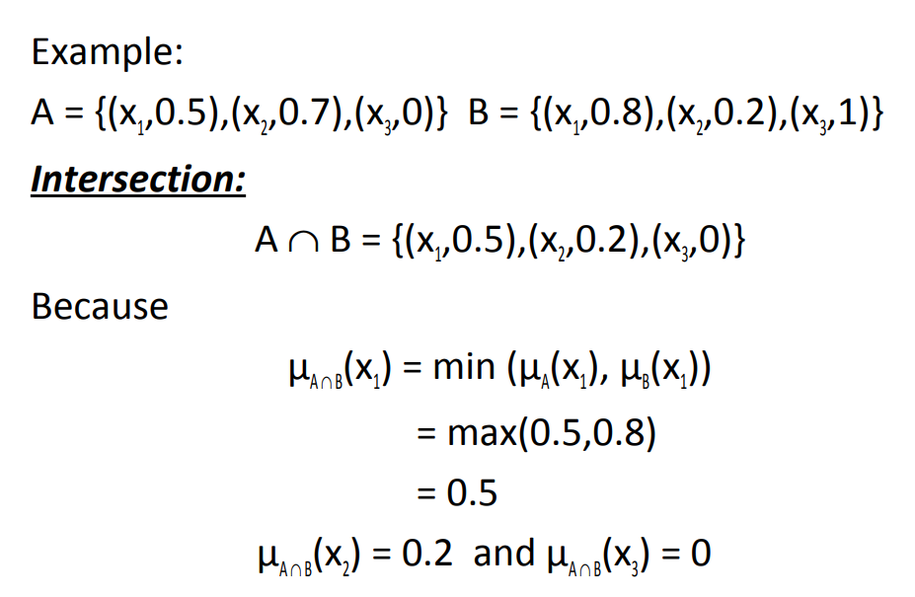

Slide 25
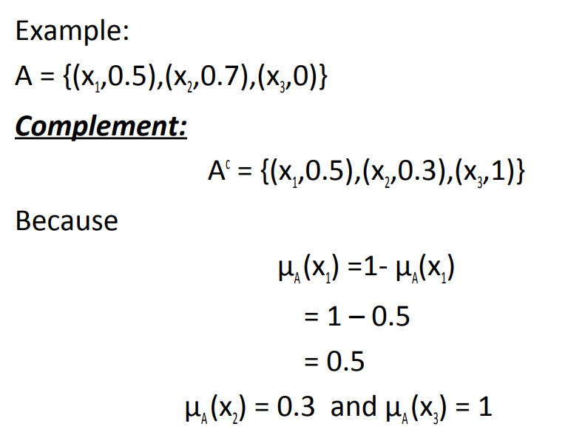

Slide 26
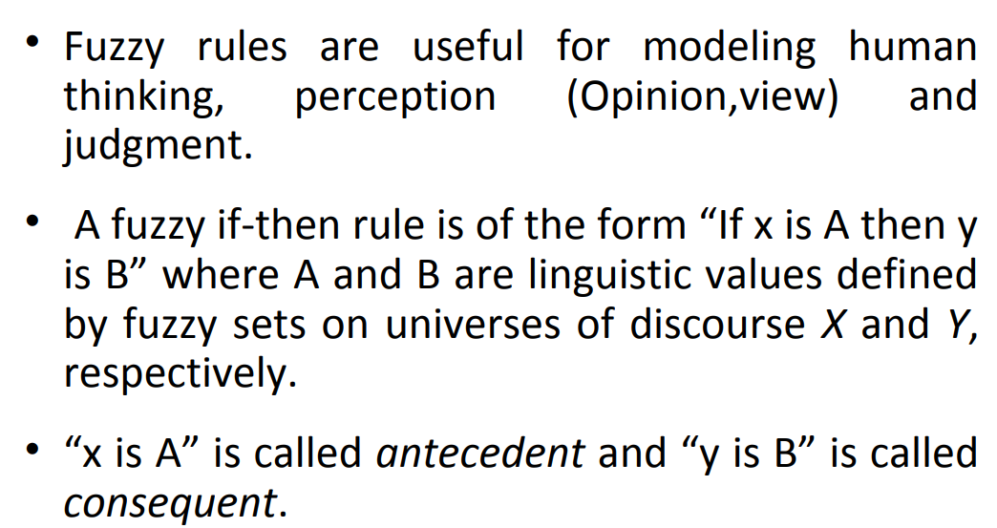
Fuzzy Rules

Slide 27
Rule Base
R1: If outlook is sunny and if humidity is high then Decision is No.
R2: If outlook is sunny and if humidity is low then Decision is Yes.
R3: If outlook is cloudy then Decision is Yes.

Slide 28
Fuzzy relations

Slide 29
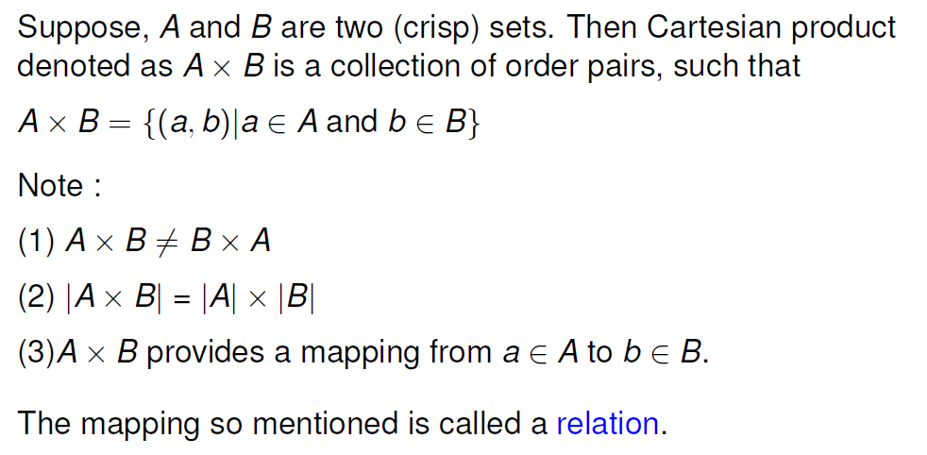
Crisp relations

Slide 30
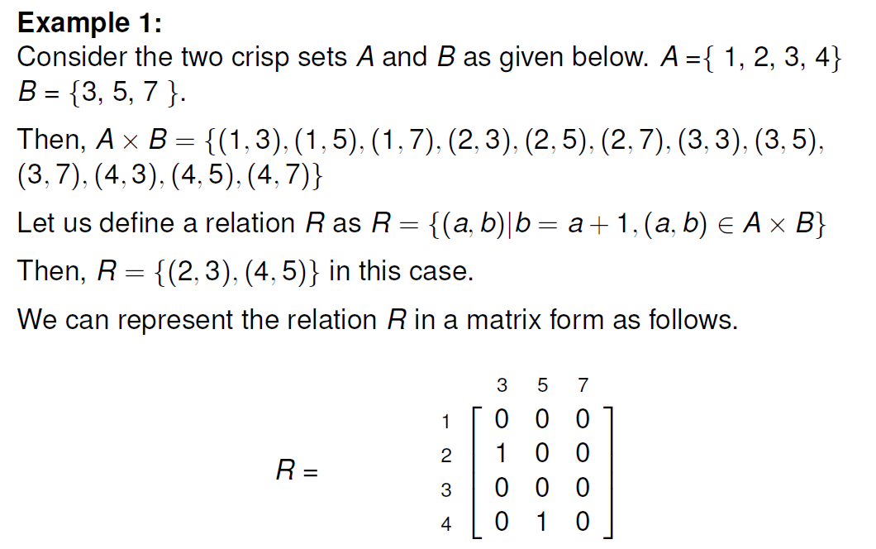

Slide 31
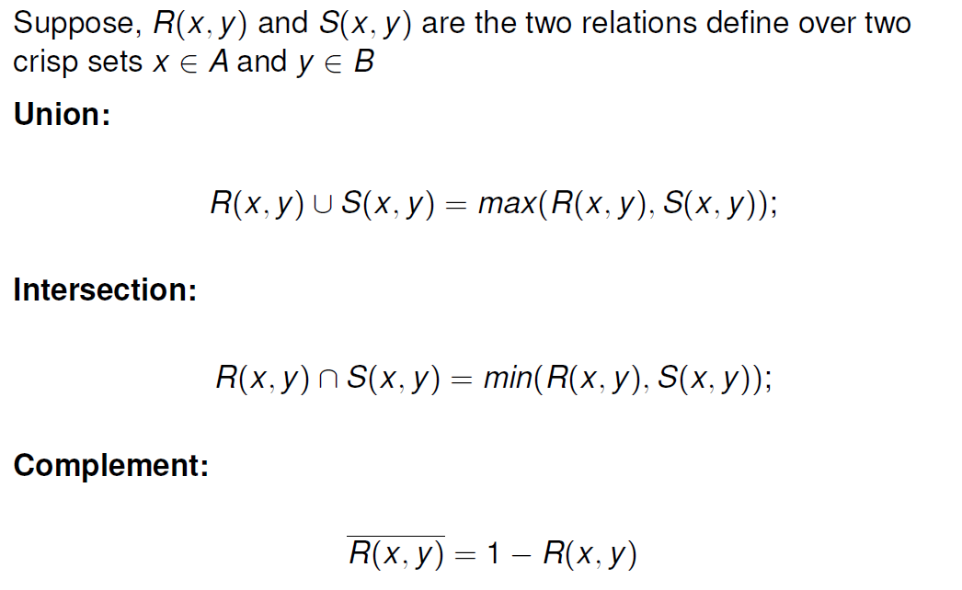
Operations on crisp relations

Slide 32
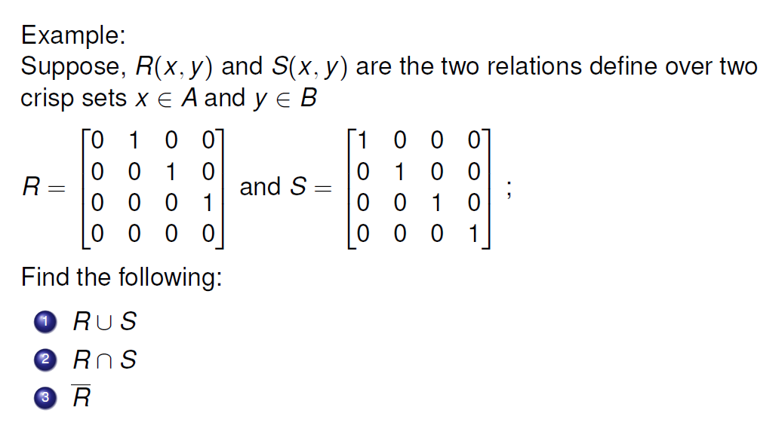

Slide 33
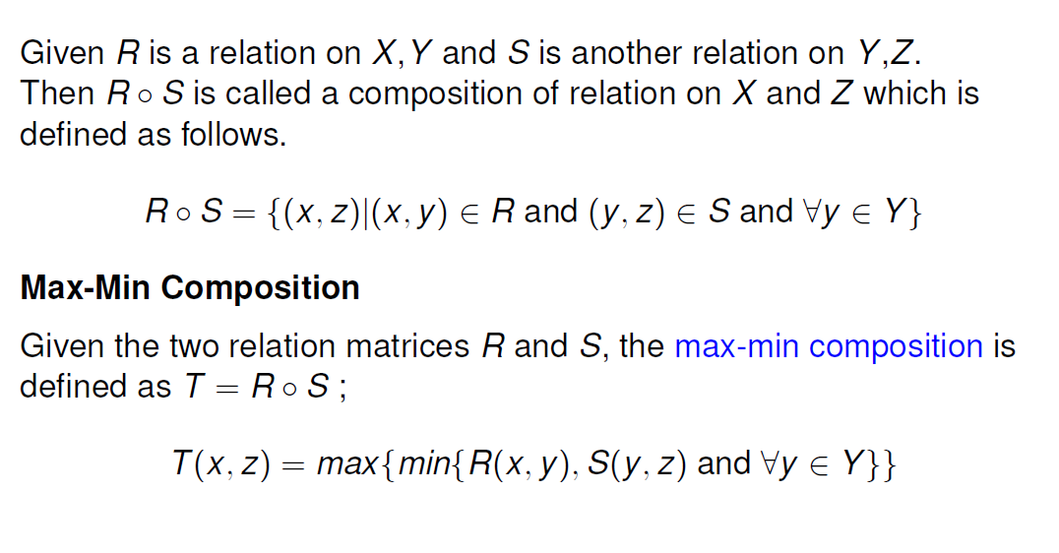
Composition of two relations

Slide 34
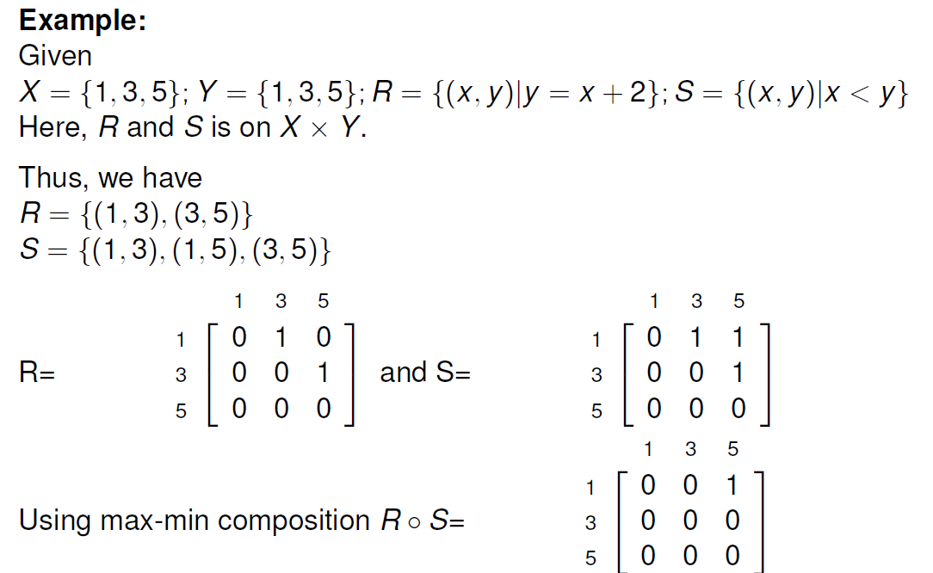

Slide 35
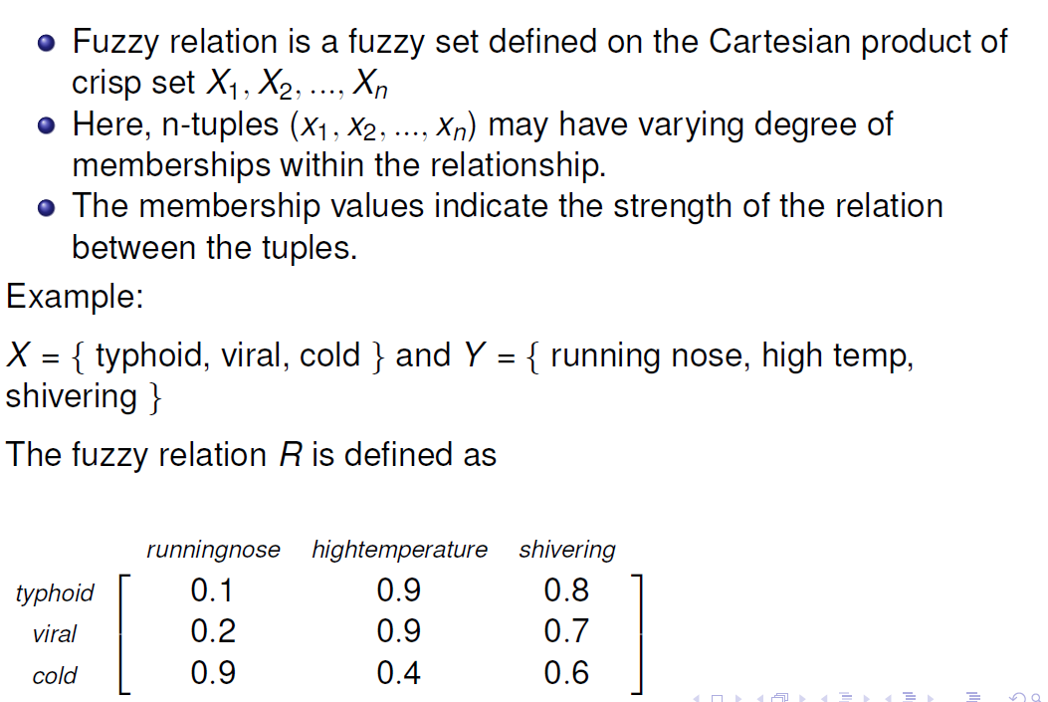

Slide 36
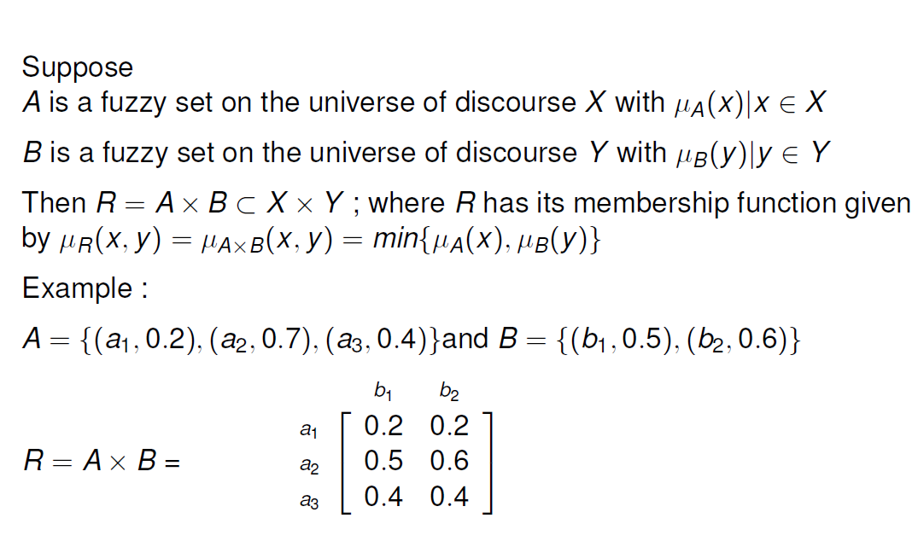

Slide 37
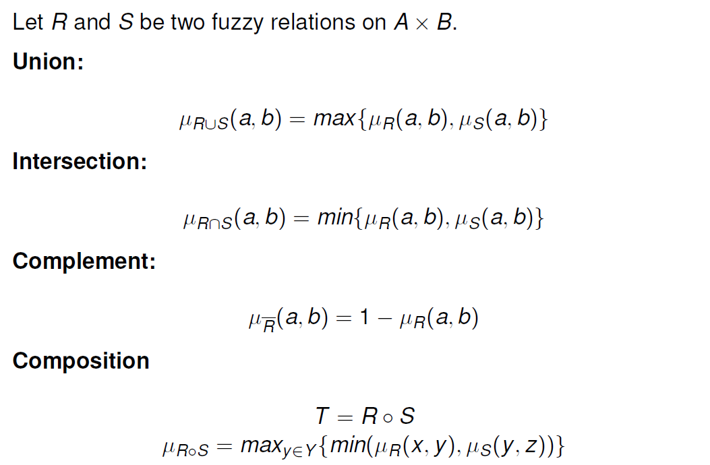

Slide 38
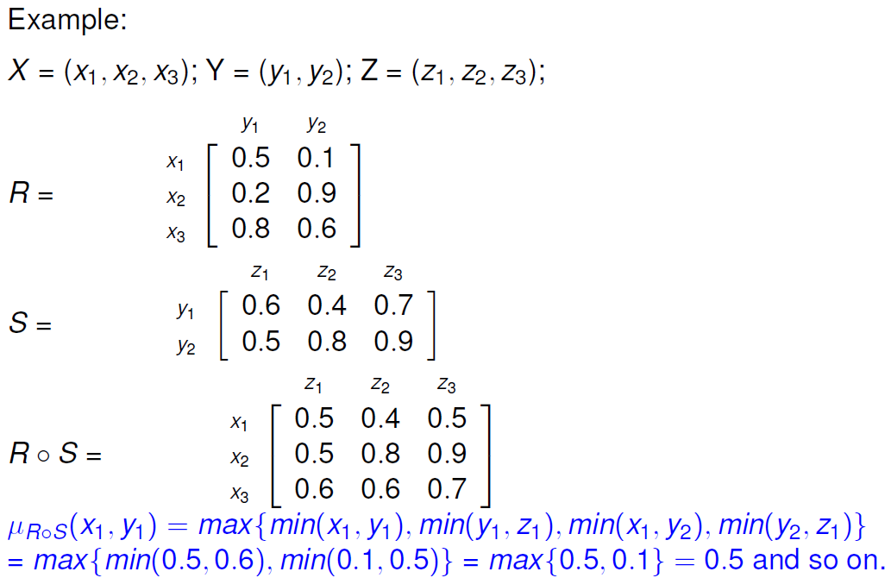

Slide 39
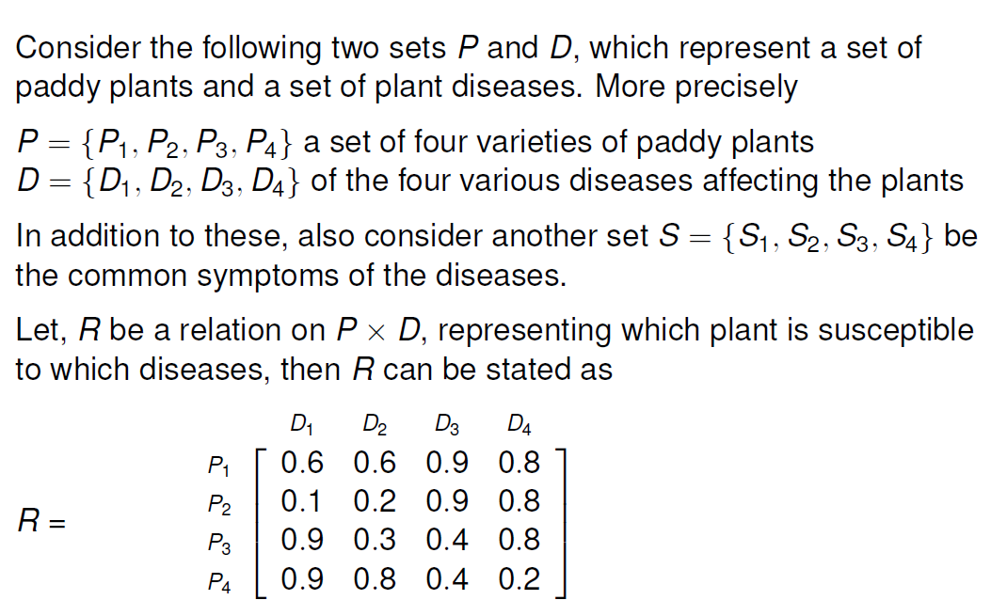

Slide 40
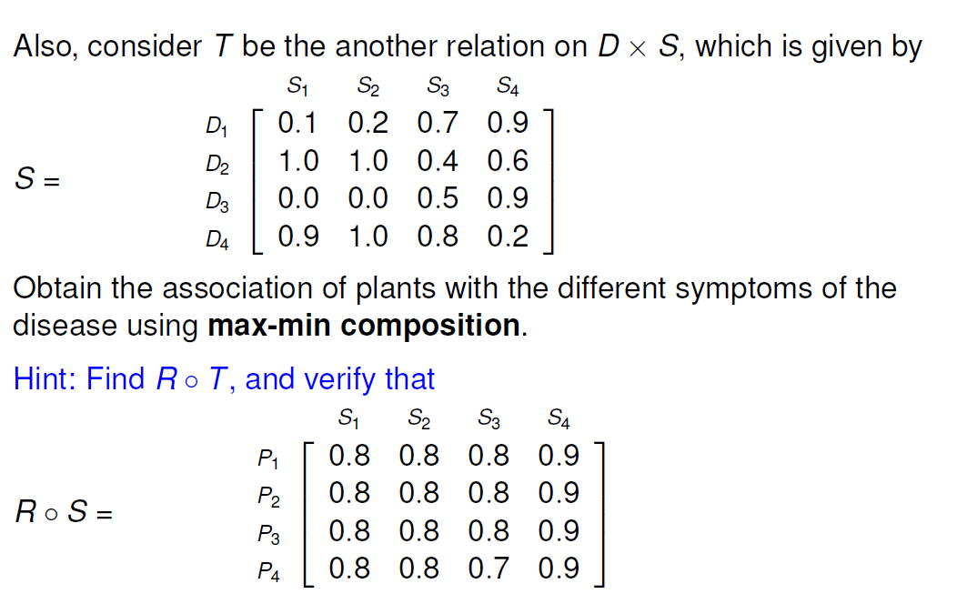

Slide 41
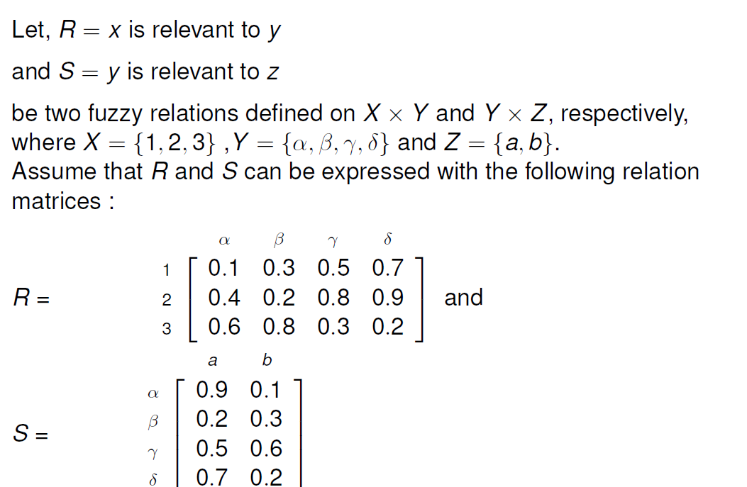

Slide 42
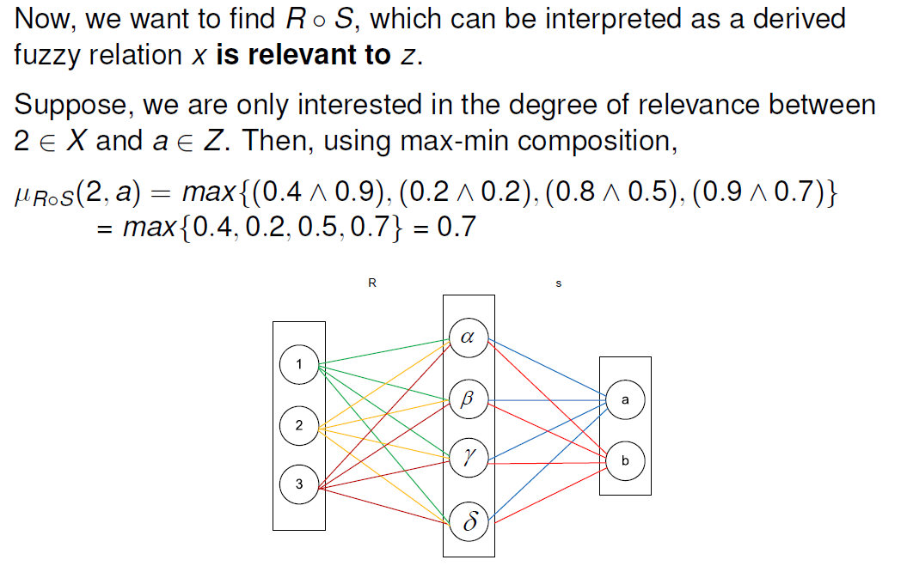

Slide 43
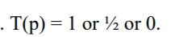
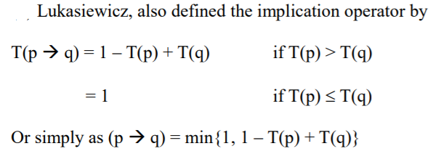
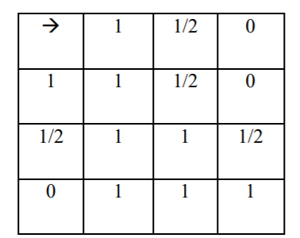
Three valued logic

Slide 44
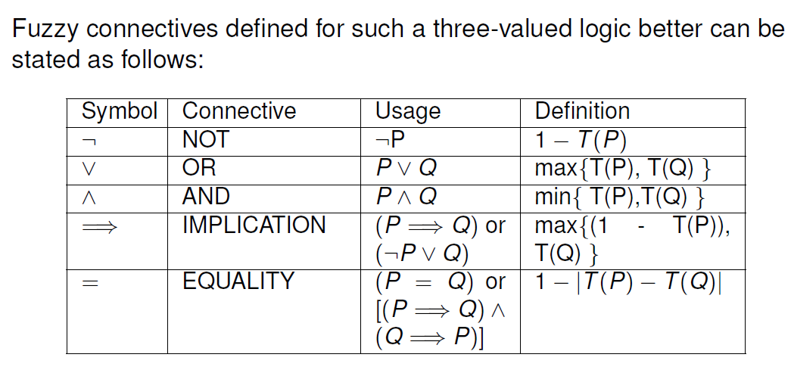
Three valued logic

Slide 45
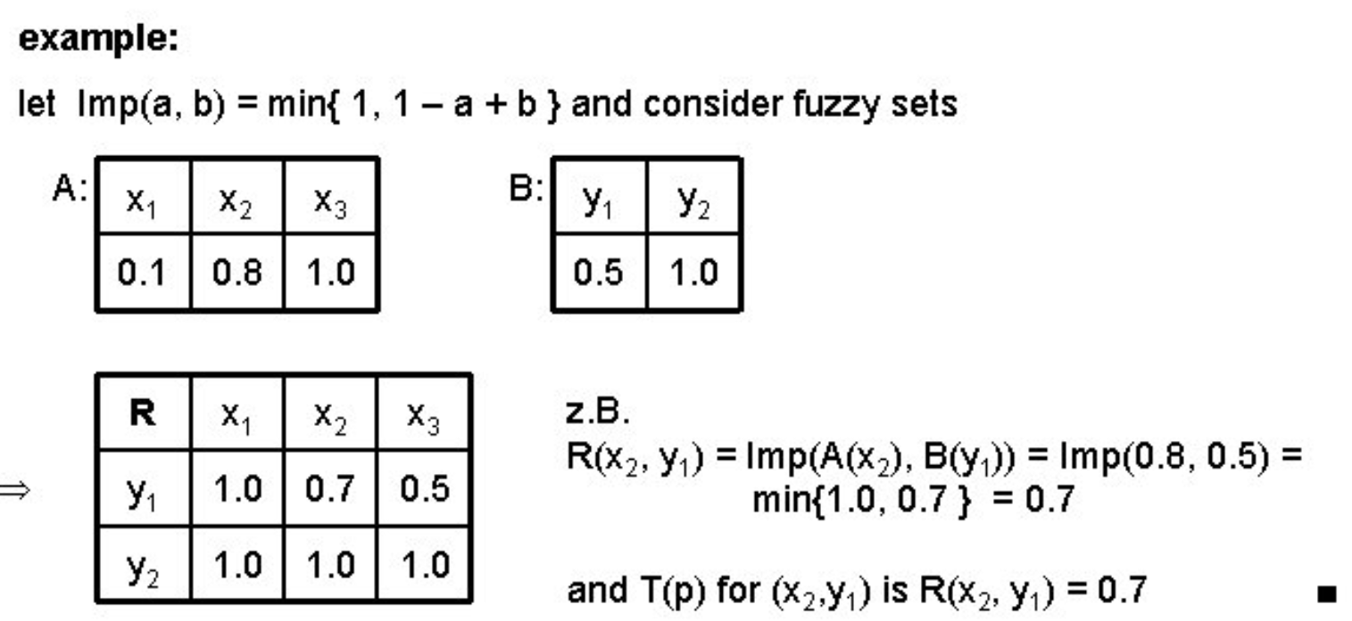

Slide 46
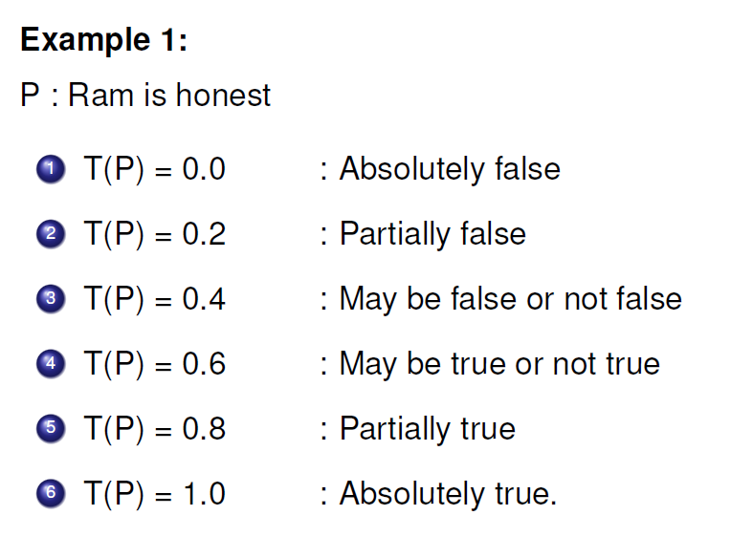
Fuzzy propositions

Slide 47
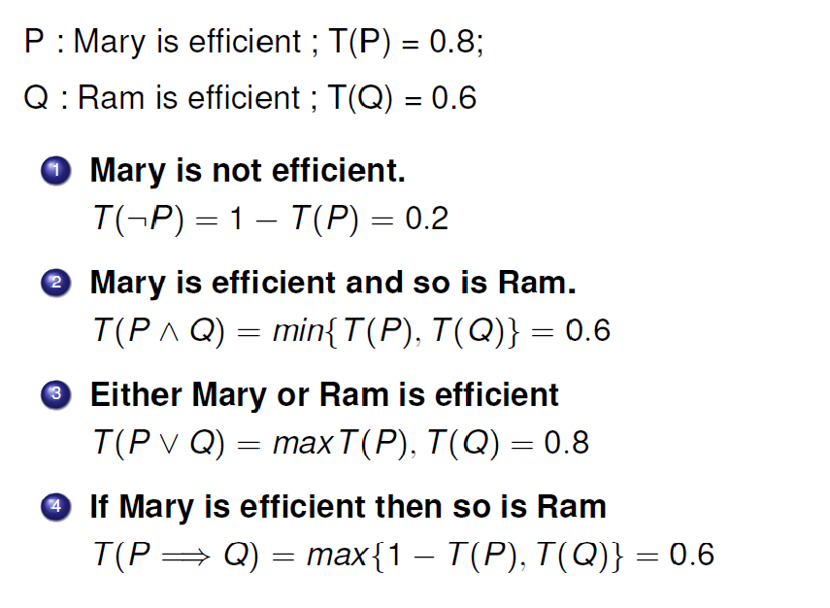

Slide 48
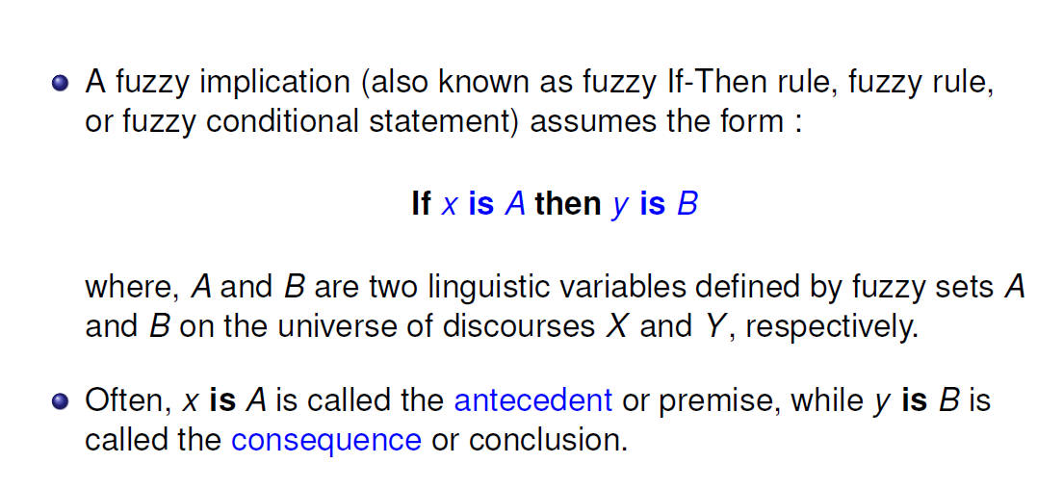
Fuzzy implications

Slide 49
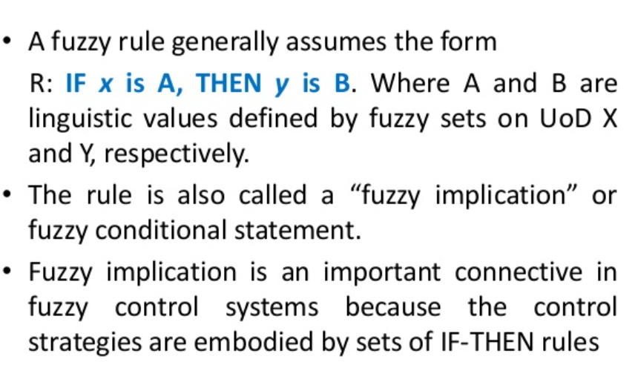
Fuzzy implication

Slide 50
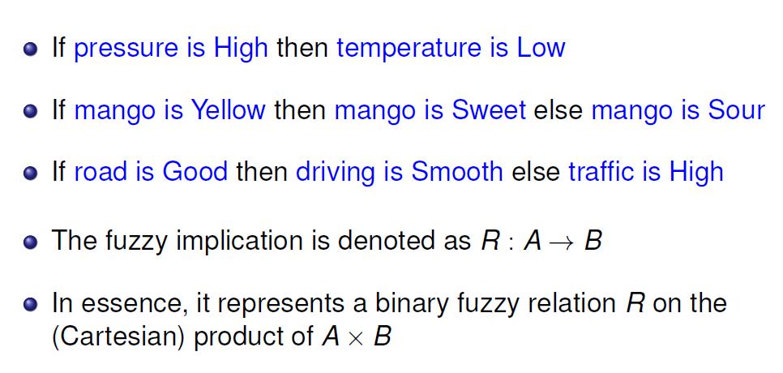

Slide 51

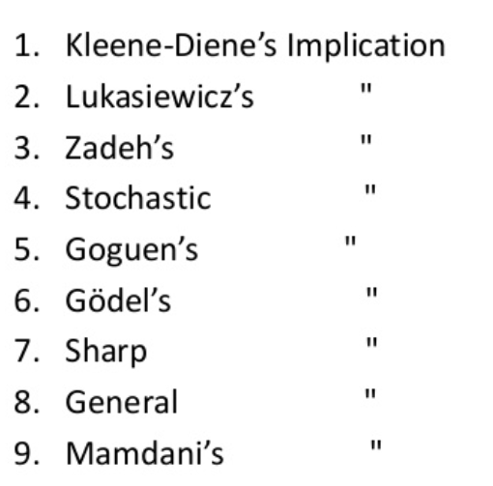
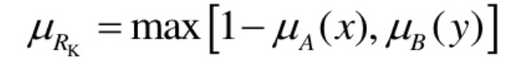

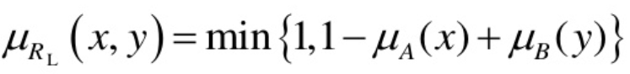





Slide 52




Slide 53


Slide 54


Slide 55

Fuzzy inference

Slide 56


Slide 57


Slide 58


Slide 59


Slide 60


Slide 61


Slide 62


Slide 63


Slide 64


Slide 65


Slide 66

Fuzzification

Slide 67

Defuzzification

Slide 68


